Slide 1





ANALOG
&
DIGITAL
HACKATHON
Under C2S Programme
Team FETManiacs
IIT GUWAHATI

Slide 2
Bandgap Current Reference (BGCR)
The objective of this design is to develop a bandgap current reference circuit that maintains a stable output current across a wide temperature range, from -40°C to 125°C, with low power consumption and excellent load regulation.

Slide 3
Specifications
Output Current : 100 µA +- 5% across the temperature range of -40°C to 125°C.
Technology : 90nm CMOS process
Power Supply : 1.8V to 3.3V
Power Consumption: Less than 50 µW for the entire current reference circuit. Temperature Coefficient : Less than 50 ppm/°C for the output current.
Load Regulation : Output current should remain stable within 2% when the load voltage varies from 0 to 1V.
Design Considerations:
Use a bandgap voltage reference to set the bias current.
Design a current mirror to generate the output current.
Consider process variations, transistor matching, and temperature stability in the 90nm process.

Slide 4
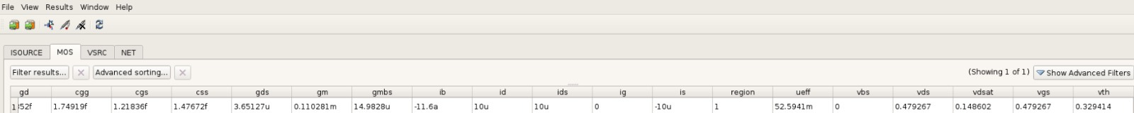
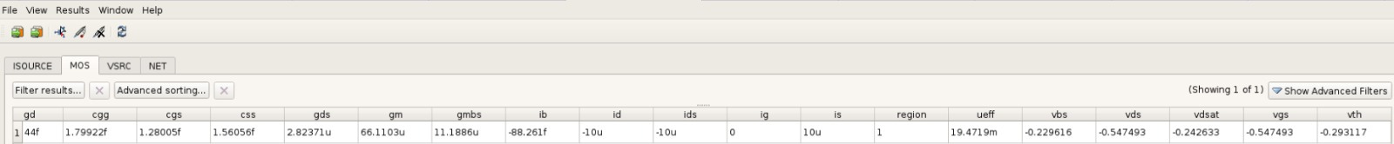
Device Characterization
NMOS (n18_t) | PMOS (p18_t)
NMOS
PMOS

Slide 5
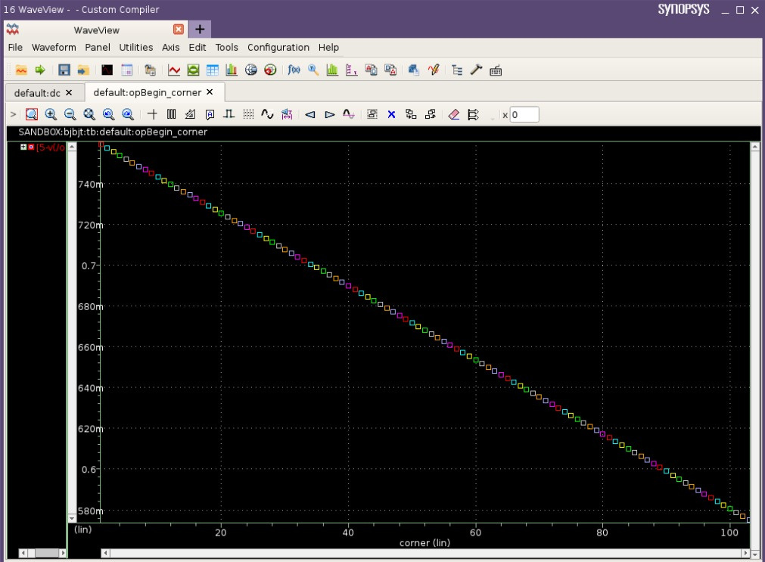
Temperature coefficient of VPNP =

Slide 6
Design
The design employs a Bandgap Voltage Reference that is converted into a current reference by adding appropriate resistors to add a CTAT current to a PTAT current and mirroring the temperature independent current using a cascode current mirror to improve load regulation.

Slide 7
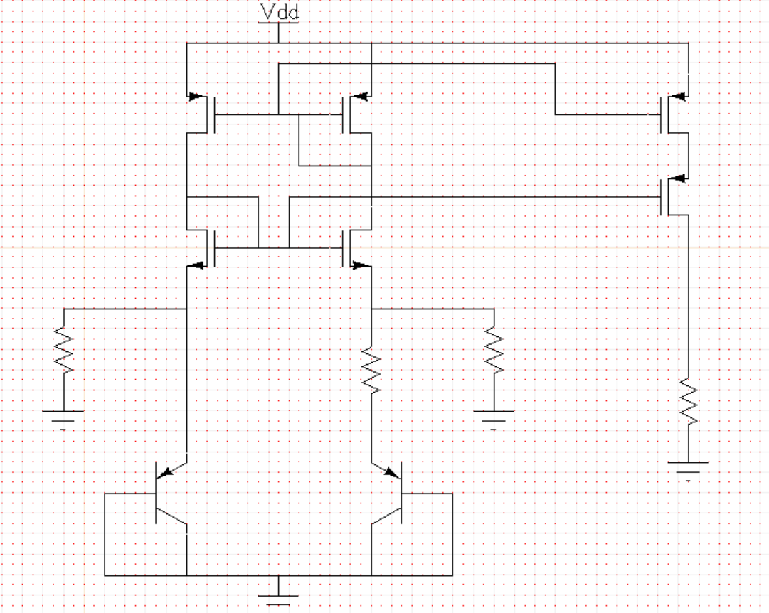

Design Schematic

Slide 8
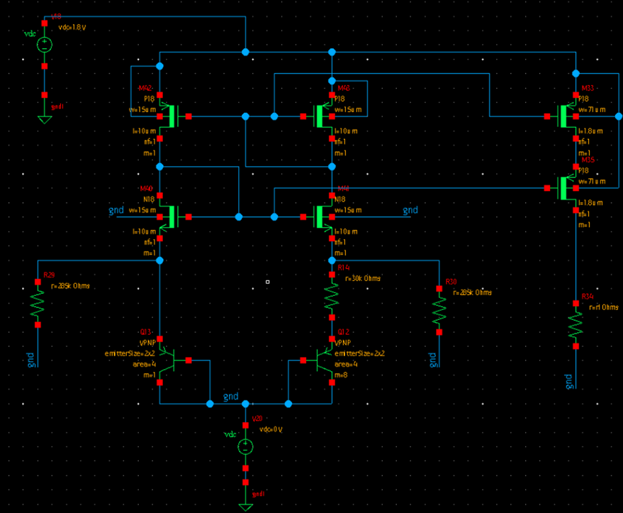
Design Schematic

Slide 9

Design Flow

Slide 10
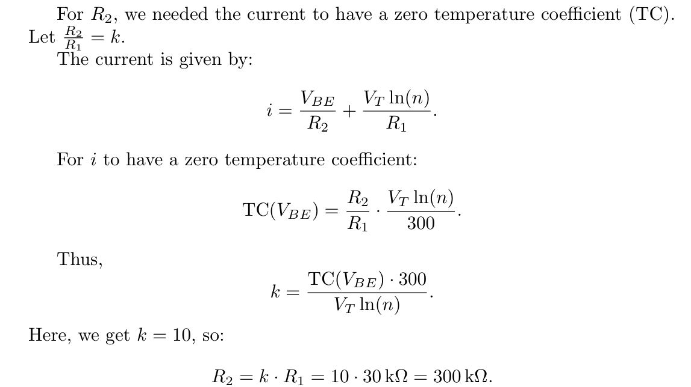

Slide 11
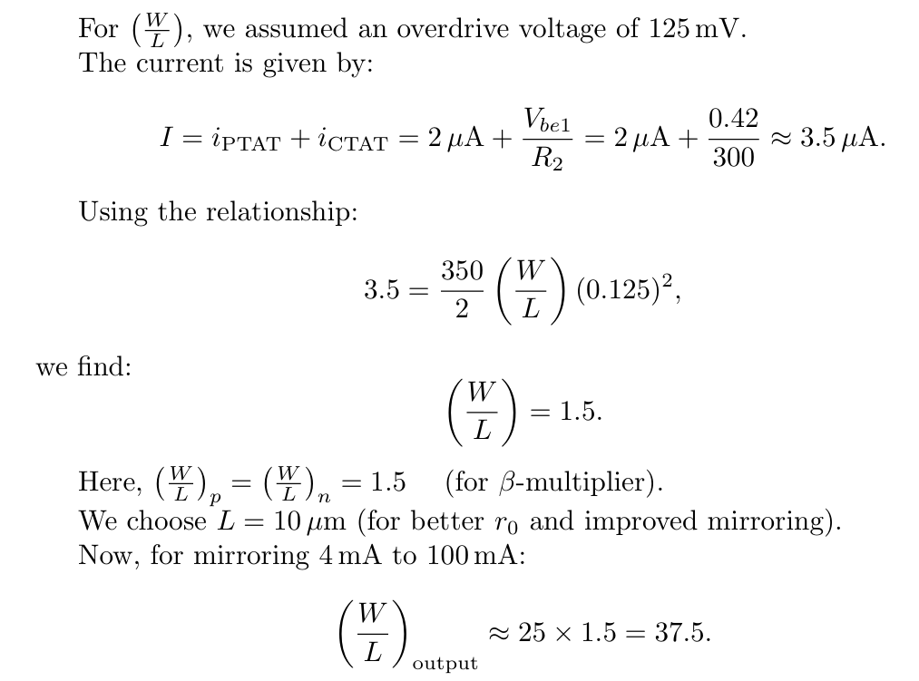

Slide 12
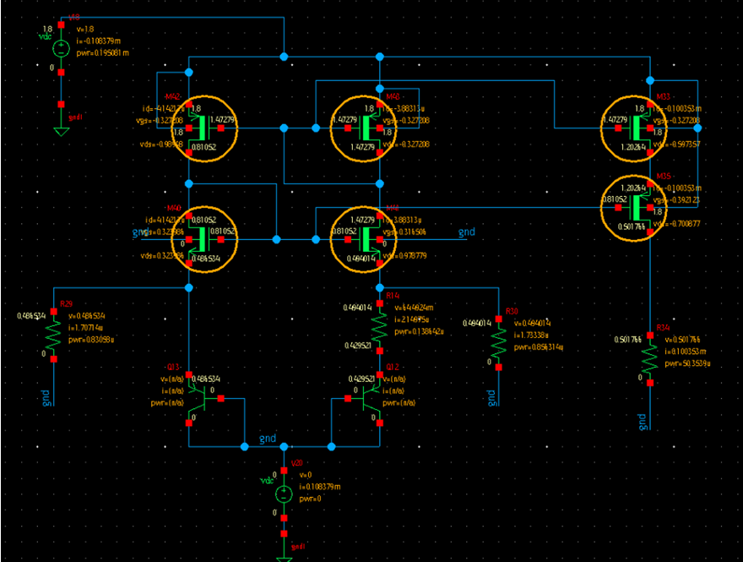
DC Operating Point

Slide 13
Performance and Achieved Specifications
Temperature Performance : The variation of current with temperature was measured, showing that the output current ranges from 99.6 µA to 100.4 µA over the temperature range of -40°C to 125°C.
This corresponds to a temperature coefficient of less than 50 ppm/°C, as required. A curvature compensated Vref design is used.
Technology used : 90nm CMOS
Power supply used : 1.8V
Power Consumption : ~20 (less than 50 )

Slide 14
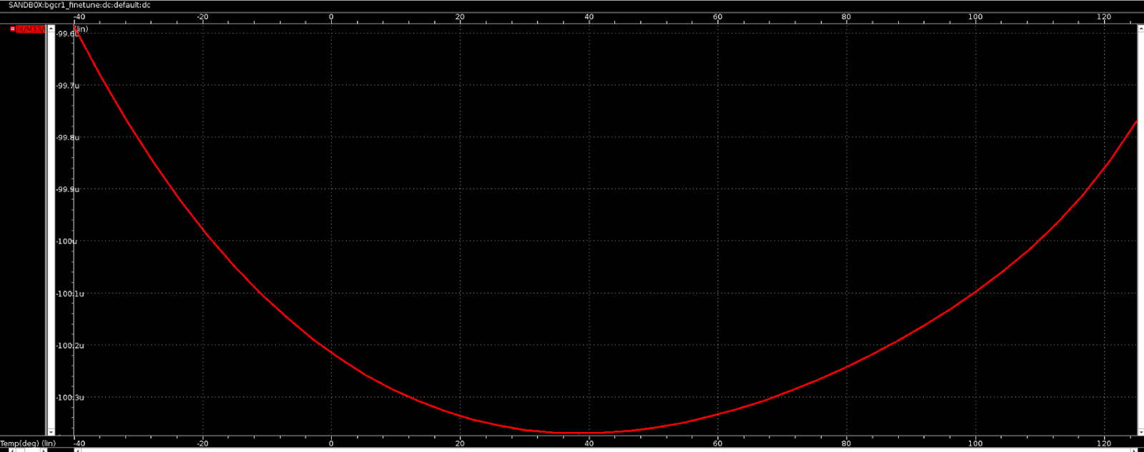
Output current sweep with temperature

Slide 15
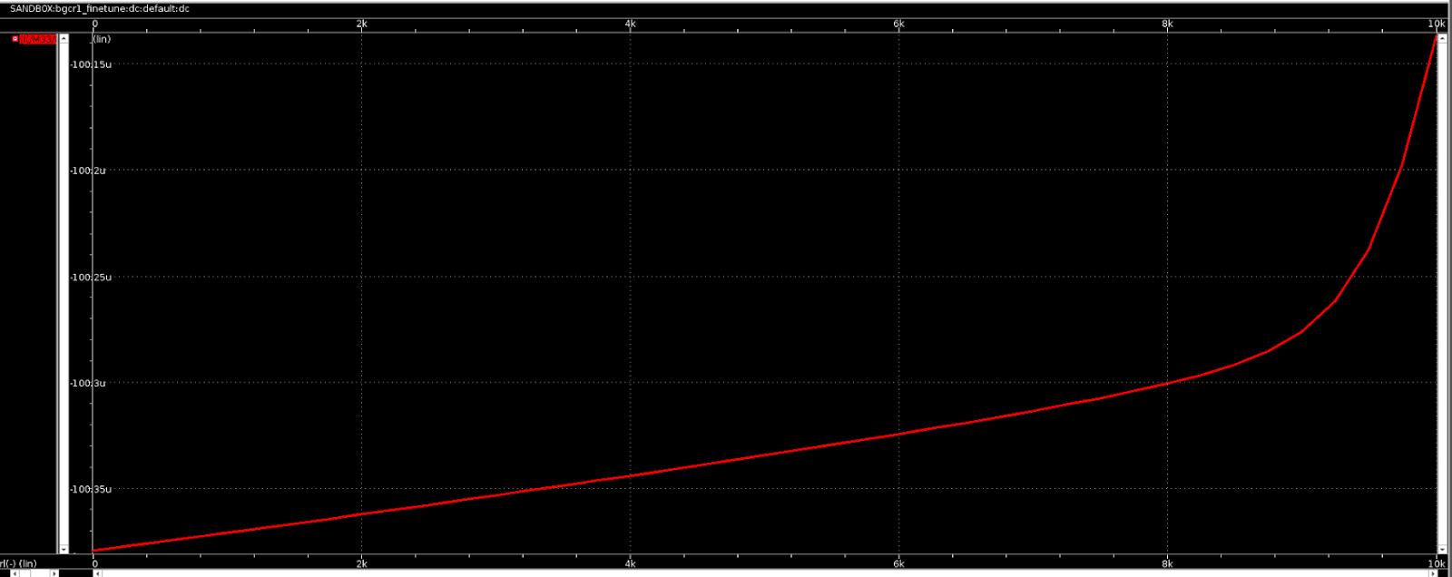
Output current sweep with temperature
Variation from 100.4 to 100.15 (0.25 % variation < 2% allowed variation)

Slide 16
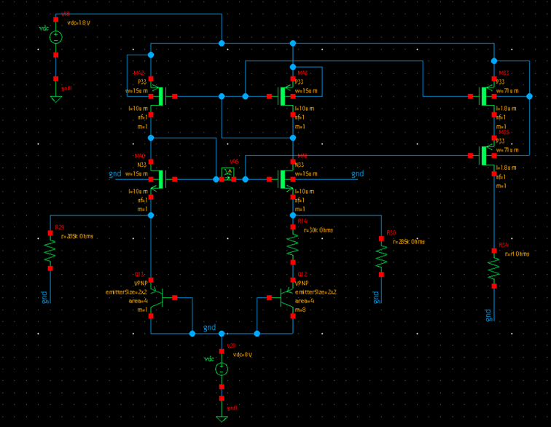
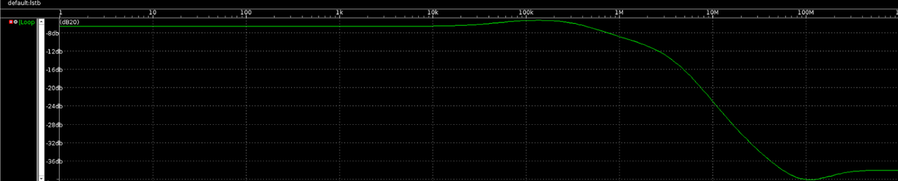
Stability Verification
A stb analysis was run using irpb method available in primewave, and the loop gain’s magnitude was found to be <1 for all frequencies, ensuring stable operation.

Slide 17
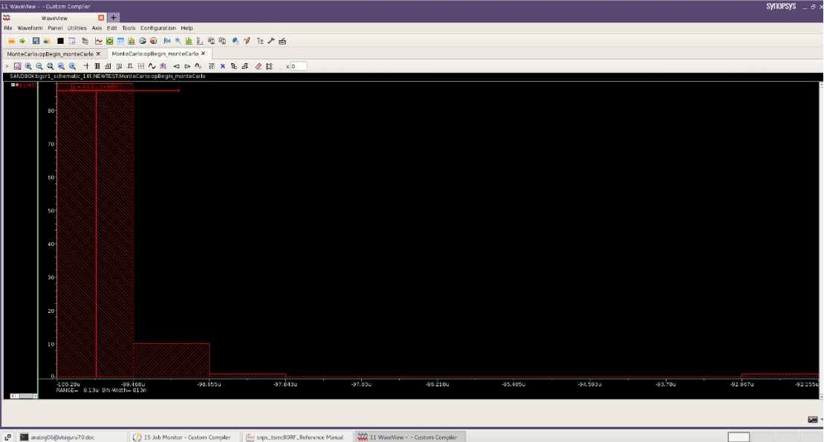
Monte Carlo Simulation
At 25 degrees, we got variance of 880 and mean of 99.9

Slide 18
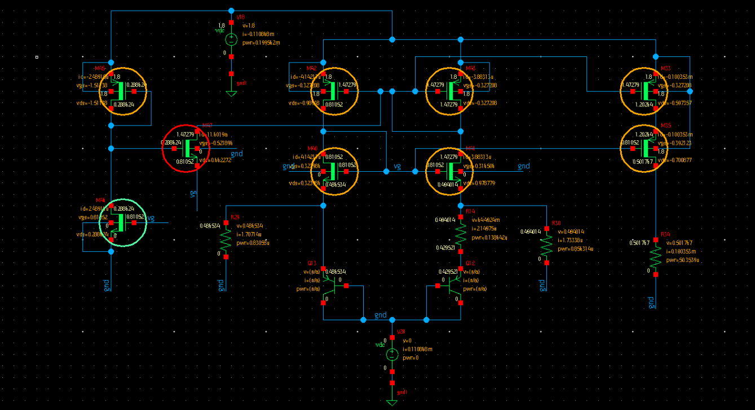
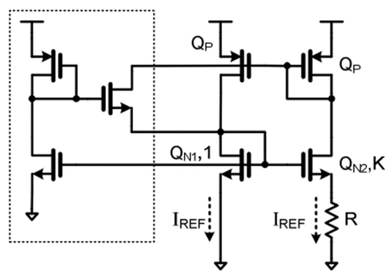
Startup Circuit

Slide 19
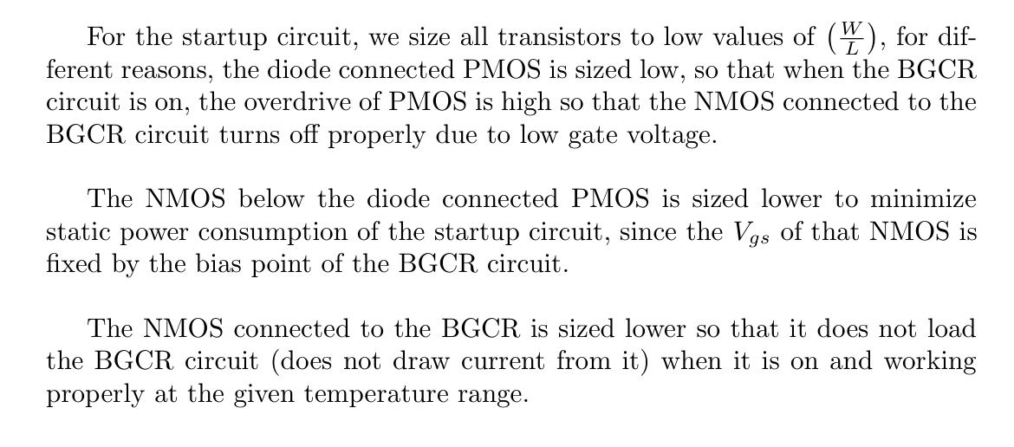

Slide 20
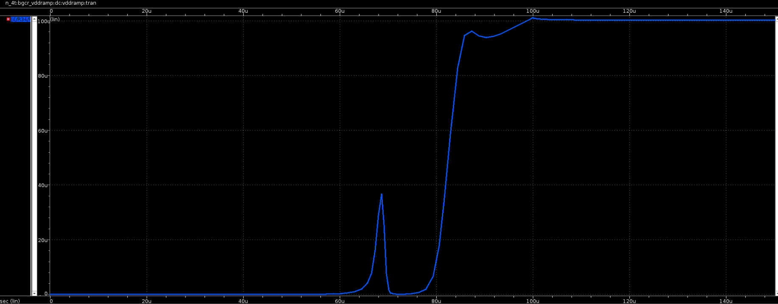
Startup Transients on a Vdd ramp of

Slide 21
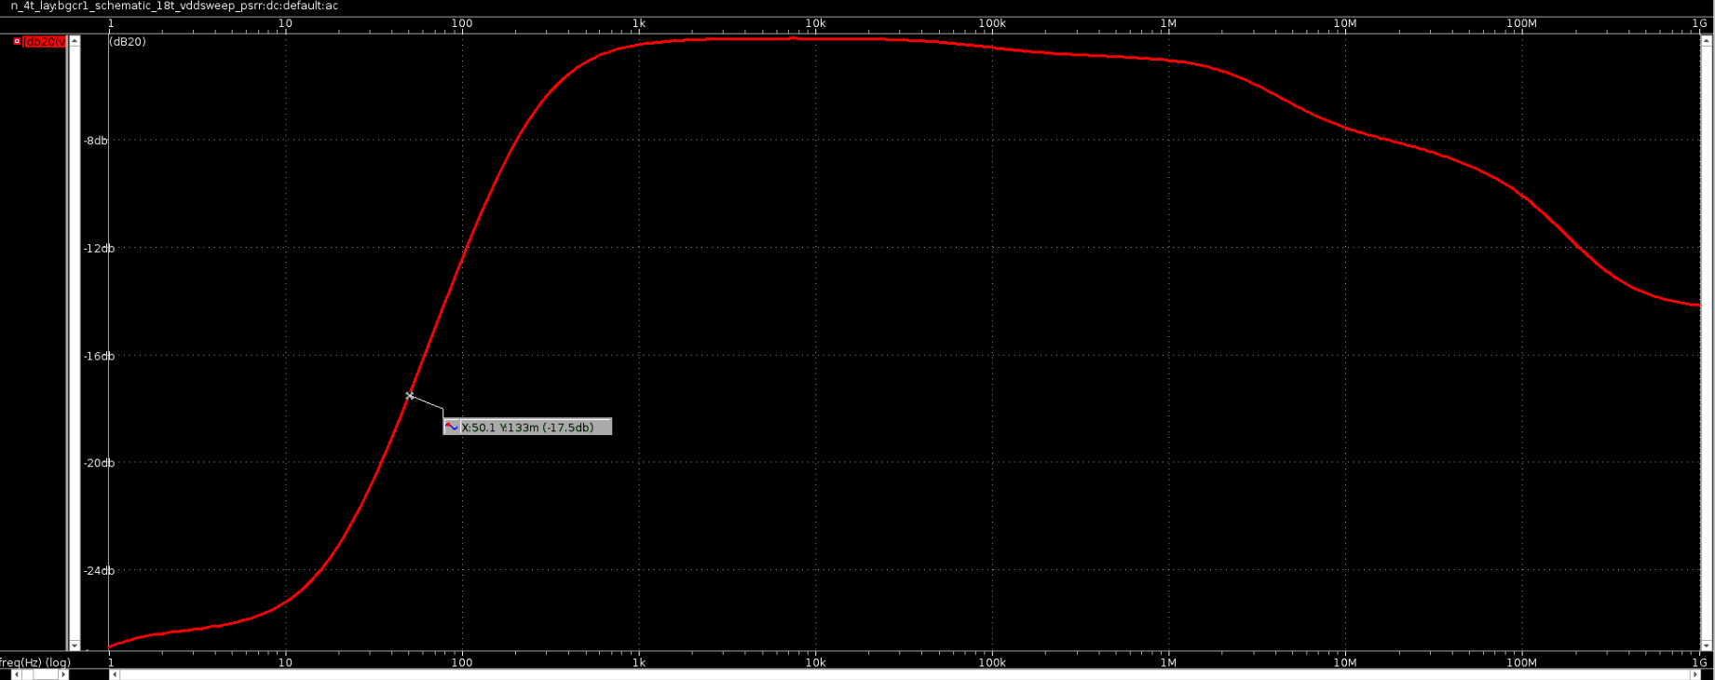
PSRR (17.5 to reject 50 supply noise)

Slide 22
LAYOUT

Slide 23

The VPNP 1:8 Layout

Slide 24
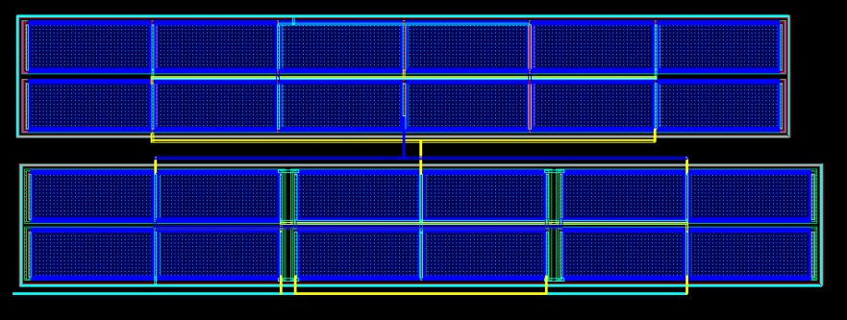
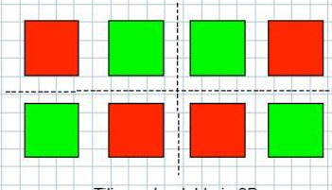
Beta Multiplier

Slide 25
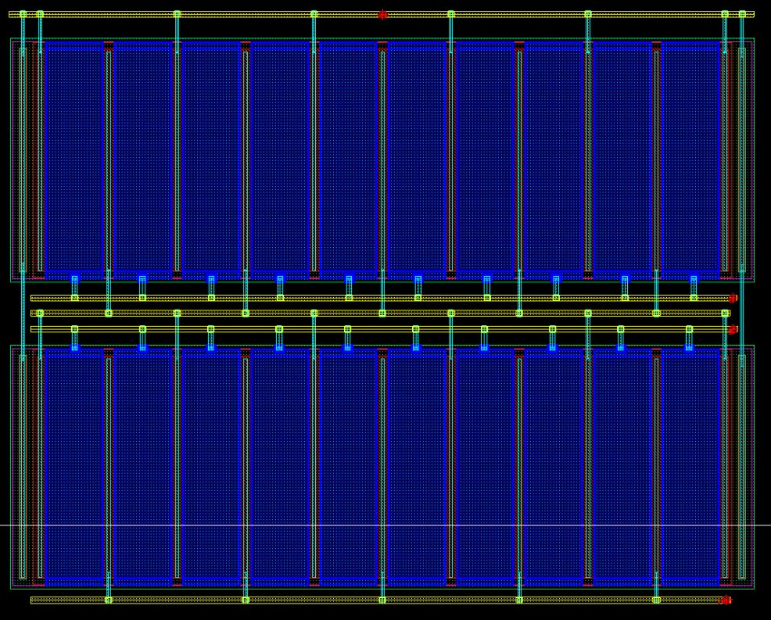
PMOS current mirror (Output Mirror)

Slide 26
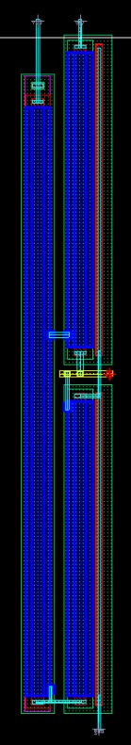
Startup

Slide 27
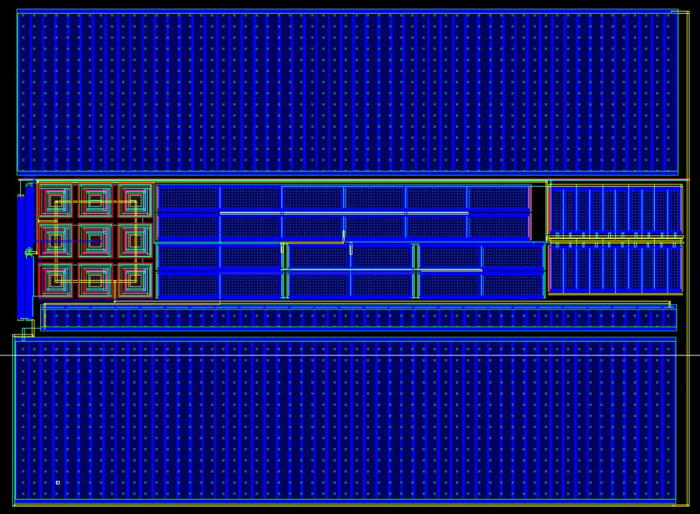
Combine
Layout

Slide 28
Smartwatches: The Ideal Use Case for BGCR
Reliable Biasing : Delivers stable current for sensors, RF transceivers, analog front ends, ADCs, and filters, enabling accurate sensing and seamless BLE communication.
Wide Temperature Resilience : Operates flawlessly across -40°C to 125°C, ensuring reliable performance in diverse environments, from extreme outdoor conditions to everyday use.
Excellent Load Regulation : Maintains ±0.2% output stability to support varying loads, such as displays, sensors, and communication modules.

Slide 29
Low Power Consumption : Consumes only 20 µW, optimizing battery life for extended use in power-constrained devices like smartwatches.
RF Stability : Ensures frequency Stability of RF oscillators, enabling consistent and reliable BLE connectivity.
LDO Integration : Acts as a dependable bias source for LDO regulators, powering multiple smartwatch subsystems efficiently.

Slide 30
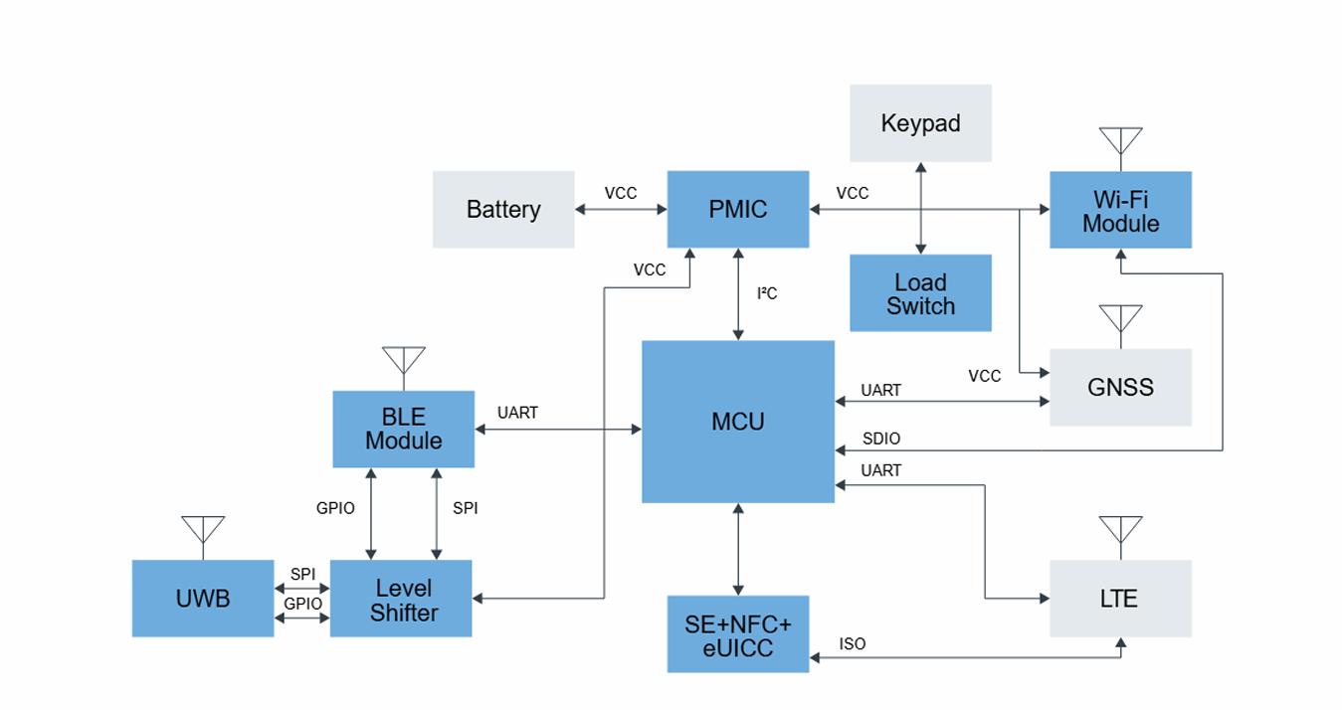
Power Management IC (PMIC) uses the
current reference to bias the MCU and Wi-fi Module

Slide 31

THANK YOU
FETManiacs

